Slide 1
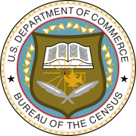
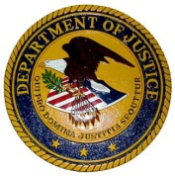


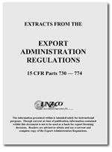
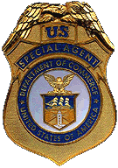







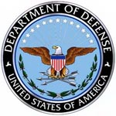


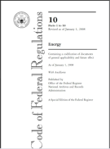
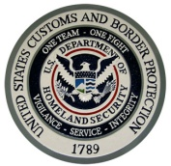
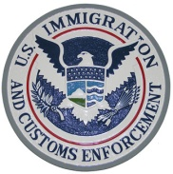
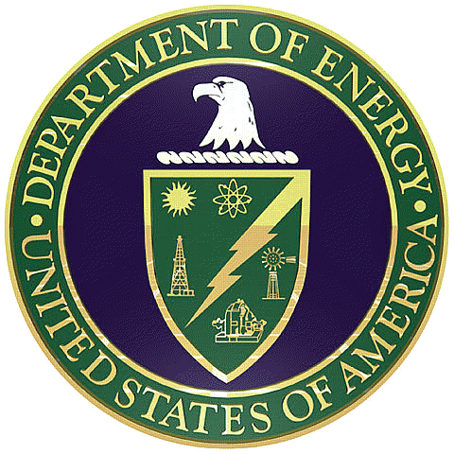
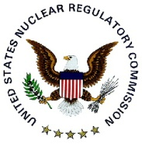

Regulatory Complexity
12 Federal Agencies plays a role in export control
Agency Export Arm Authority Regulations Enforcement Investigations
DoC
Census
Export Administration Act of 1969
15 CFR EAR
19 CFR (CBP)
DoJ
BIS
PTO
Office Export Enforcement
DoS
Threat Reduction
FBI
DSS
CIA
Arms Export Control Act of 1976
22 CFR ITAR
ODTC
DoD
DDTC
Operations
DDTC - Enforcement
Licensing
Executive Order 8389
Sanctions
DoT
Trading with Enemy Act
31 CFR
International Emergency Economic Powers Act
Various Statutes
DHS
OFAC
OFAC - Compliance
DoE
Energy Reorganization Act of 1974
10 CFR
CBP
ICE
(Enforcement)
NNSA Export Control
Notes:
The U.S. Departments of State, Commerce, Homeland Security, Treasury, Defense, and Energy each play a critical role in export control and nonproliferation activities both within the United States and outside its borders.

